Slide 1

Image Document Optimizer
Joy Maitra

Slide 2



Agenda
Objective
Approach
Architecture

Slide 3




Introduction
A Huge volume of documents need to be maintained, re-used, preserved for operational activities during the Loan & Deposit Account lifecycle. Optimization is required for these documents to help efficiently store / retrieve the documents.

Slide 4

Objective

Slide 5
Problem Statement
Documents are used during the process of daily operations and are stored as image files or in PDF.
The documents can be of varied types such as:
Application forms
Customer Request forms
Account Opening Forms
KYC Documents
Agreements
Reports
Certificates
Confidential Reports
Account Statements
Varied document formats including OVDs
A Huge volume of documents need to be maintained, re-used, preserved for operational activities during the Loan & Deposit Account lifecycle. Optimization is required for these documents to help efficiently store / retrieve the documents.

Slide 6
Approach

Slide 7
Consideration for solution
Core
Security
Governance
You can use Form Recognizer as part of an automated data processing pipeline built with Azure Functions. This guide shows you how to use an Azure function to process documents that are uploaded to an Azure blob storage container. This workflow extracts table data from stored documents using the Form Recognizer Layout service and saves the table data in a .csv file in Azure. You can then display the data using Microsoft Power BI (not covered here).
Data in Azure Storage is encrypted and decrypted transparently using 256-bit AES encryption, one of the strongest block ciphers available, and is FIPS 140-2 compliant. Azure Storage encryption is similar to BitLocker encryption on Windows.
Azure Storage encryption is enabled for all storage accounts, including both Resource Manager and classic storage accounts. Azure Storage encryption cannot be disabled.
Azure VNet service will keep the external users network isolated from the internal network where the data will be stored and processed.
There are 2 sets of users to the application. The first set, who uploads the scanned documents to the storage location in the Azure. The second set, who uses the data processed from prepared from the scanned documents, these can be the data stewards validating the data quality and the data analyst, deriving insight from the data.
To govern the access of these different set of users to the data, users will be identified using Active Directory service of Azure.

Slide 8

The way to get started is to quit talking and begin doing.
Walt Disney

Slide 9
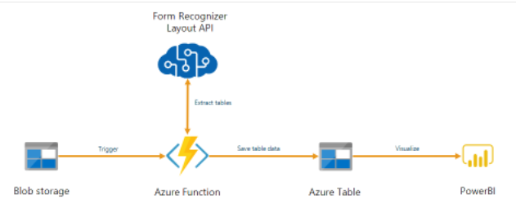

Architecture
Users uploading scanned document
VNet 2
Users accessing the processed data
VNet 1
VNet 1

Slide 10
Timeline
Repeat the activities of the last 2 phases till all the Documents are processed and validated.
1 week
Setup Azure account with security and selected services
1 week
Team identification, onboarding and Business Unit-wise document prioritization
2 week
Upload scanned document to blob storage and loading the structured output data to Azure table and PowerBI.
1 week
Data Validation by BUs using the visualization tool

Slide 11

Summary
I am a Senior solution Architect with experience in the deployment of similar solutions in multiple enterprises. The solution provided above is the Holistic overview of how to address the problem statement, not only from core aspects but also on the security of the data. HIPAA and other compliance and are of utmost importance when it comes to personal data of the customer. The approach also need to have data governance in place to limit the data consumers to have limited and encrypted/masked data access.
Why consider my solution

Slide 12


Thank You
Joy Maitra
Joy_maitra@yahoo.co.in
Linkedin : /joy-maitra

